Slide 1

VBA Training
Integrating People, Process and Technology
Prepared by
Risk Management Department (RMD)
Markets Research & Development Department (MRDD)

Slide 2
Outline
Introduction
Background of Visual Basic for Application (VBA) and its general uses
What is Object-Oriented Programming (OOP) and its connection with VBA
Hands-on VBA practices
Creating a Module in Visual Basic Editor (VBE)
Designing Subs and Functions
Running simple macros
Understanding Data Types and Declaring Data Variables
Writing Operators
Writing Comments
Debugging Macros
Decision Trees, Cases and Loops
Recording Macros

Slide 3


Slide 4
Background on VBA
An abbreviation for Visual Basic for Applications
Microsoft's common application programming (macro) language for Word, Excel, Access, etc.
Also implemented in other Microsoft applications such as Visio and AutoCAD etc.
Object Oriented Programming (OOP) language: More details on subsequent slides
VBA and VB have a lot in common, but they are different. VB is a programming language that lets you create standalone executable programs.

Slide 5
General Uses
Write macros to automate labor-intensive and repetitive tasks
Create user-defined functions to achieve complicated functionality
Create standard Windows Menu/Tool Bars for interface
Interact with other Windows programs (e.g. Matlab)
I/O with external files
Database operation
…

Slide 6

What is Object Oriented Programming?
Object = Car
Properties
Model
Color
Year
Price
Events
Start_OpenDoor
Start_Ignition
Start_SwitchGear
…
…
Methods
Start
Accelerate
Brake
Reverse

Slide 7
Components of VBA Object Oriented Programming
Containers or Collections
A group of similar Objects that share common Properties, Methods and Events, e.g.Workbooks, Worksheets, etc.
Worksheets is a collection of all the Worksheet objects in the specified or active workbook.
To reference a single object from a collection, e.g. Sheet1 in Excel, enclose the object’s name in parentheses after the name of the collection:
Worksheets(“Sheet1”)
If Sheet1 is the first worksheet in the collection, this also applies:
Worksheets(1)

Slide 8
Components of VBA Object Oriented Programming (cont’d.)
Objects
Such as Worksheet, Workbook, Range, Cell, Chart, Name, etc.
Worksheets(1) is an Object Referring to the First Sheet
Range("A1:B15") is an Object Referring to a Range (i.e. Cells A1:B15) in the active worksheet.
Columns(1) is an Object referring to the first column (column A) in the active worksheet
Rows(2) is an Object referring to the second row (row 2) in the active worksheet

Slide 9
Components of VBA Object Oriented Programming (cont’d.)
Working with Range Objects
A Range object is a single cell or range of cells on a worksheet. A range object is contained in a Worksheet object. 3 methods to access range object:
Use dot . to refer to a child object, such as Range. Dot . is also used to refer to the collection’s / object’s properties and methods
Methods | Syntax
Range | Object.Range(cell1, [cell2]) Example: Worksheets(“Sheet1”).Range(“A1”) Example: Worksheets(“Sheet1”).Range(“A1:B15”) Example: Worksheets(“Sheet1”).Range(“A1”, “B15”)
Cells | Object.Cells(rowIndex, columnIndex) Example: Worksheets(“Sheet1”).Cells(1,2)
Offset | Object.Offset(rowOffset, columnOffset) Example: Worksheets(“Sheet1”).Offset(1,2)

Slide 10
Components of VBA Object Oriented Programming (cont’d.)
Properties
Properties are the physical characteristics of Objects
Can be measured or quantified
Use dot . to access the collection’s / object’s properties
Properties for Collection:
- Worksheets.Name (Read Only)
- Worksheets.Visible = True (Read and Write)
Properties for Object:
- Range("A1").Value (Read Only)
- Range("A1:B15").Font.Bold = True (Read and Write)
Make use of Excel VBA’s auto-completion feature (i.e. Intellisense) for data variables, methods and properties

Slide 11
Components of VBA Object Oriented Programming (cont’d.)
Methods
Methods are the actions that can be performed by Objects or on Objects
Again, use dot . to access the collection’s / object’s methods
Methods for Collection:
- Worksheets.Add
- Worksheets.Delete
Methods for Object:
- Range("A1:B15").ClearContents
- ActiveCell.Copy
Make use of Excel VBA’s auto-completion feature (i.e. Intellisense) for data variables, methods and properties

Slide 12
Components of VBA Object Oriented Programming (cont’d.)
Events
Actions performed by users that trigger Excel VBA to execute code, such as Mouse Click, Double Click on a Cell, Open/Close/Save a Workbook, etc.
Worksheet Events: e.g. Activate, Deactivate, Change, Selection Change, Before Double Click, etc.
Workbook Events: e.g. Activate, Deactivate, Open, Before Close, Before Saving, Before Print, New Sheet.
These events are built-in procedures inside Excel

Slide 13
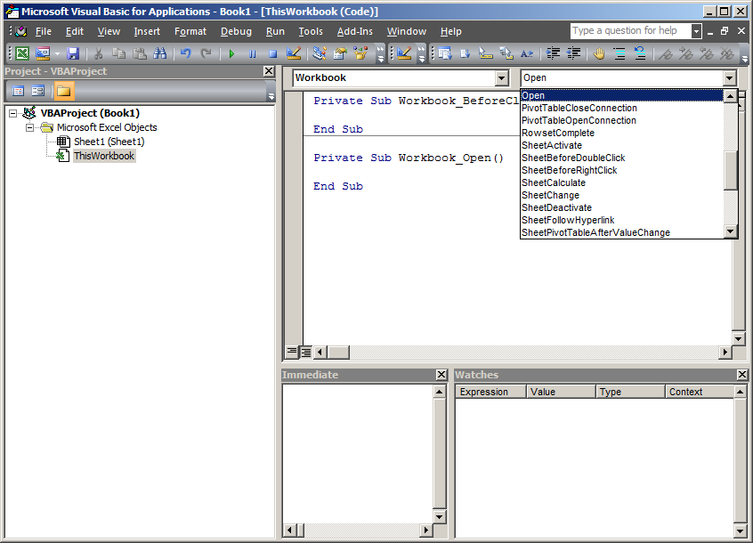
Components of VBA Object Oriented Programming (cont’d.)
Events
Examples of sheet events provided in Excel

Slide 14
Components of Object Oriented Programming (cont’d.)
Summary

Slide 15


Slide 16
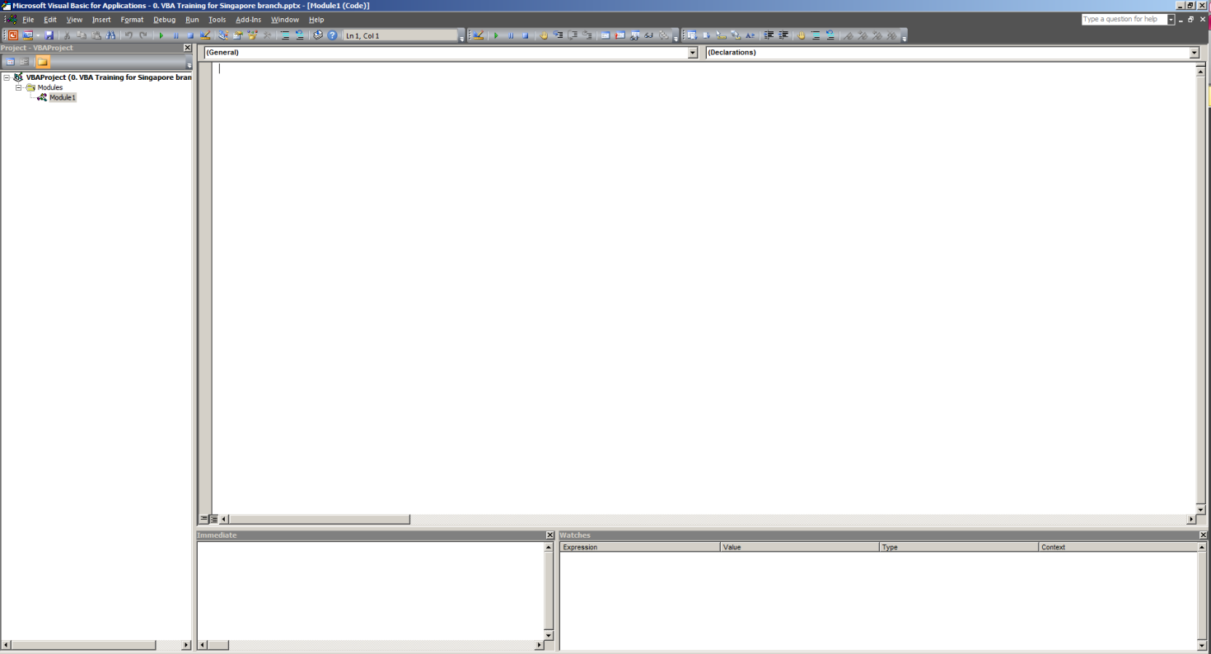
Introduction to VBE
An abbreviation for Visual Basic Editor
Application for creating, running and testing VBA codes (macros)
To open VBE, press and hold Alt, then press F11 (i.e. Alt + F11). Alternatively, in the ribbon/toolbar above MS Excel, go to Developer menu > Visual Basic.
Notes:
Displaying the ‘Developer’ Ribbon: https://www.techonthenet.com/excel/questions/developer_tab2013.php

Slide 17
Creating a Module
Modules
Storage of Procedures (i.e. series of VBA commands grouped together to perform a specific task)
Event procedures: Run in response to specific actions you perform on an object; Refer to Slide 10 for more information
Subroutine procedures: Perform a specific task, but does not return a value
Function procedures: Denoted by keyword Function; Returns a value
Class Modules
User Forms

Slide 18
Designing Subroutines and Functions
Sub (routines)
No value returned
Called without parenthesis mySub param1, param2
Called with parenthesis Call mySub(param1, param2)
Functions
Value returned
Assign return value to function name

Slide 19
Examples for Subs and Functions
Sub Test()
sum = 1 + 1
MsgBox “The answer is ” & sum
End Test()
Function AddTwoNumbers(arg1, arg2)
AddTwoNumbers = arg1 + arg2
End Function
Start and Name of Subroutine
VBA Commands
End of Subroutine
Start and Name of Function
VBA Command
End of Function

Slide 20

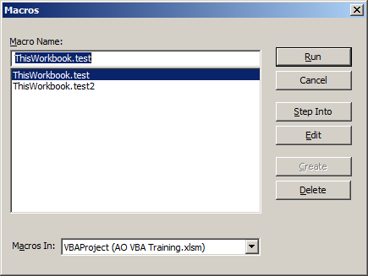
Running Macros
To run a macro in VBE:
Place your cursor inside the Sub or Function you want to run then press F5
Alternatively, in the toolbar buttons on the top part of VBE, click the play button then select the Sub or Function you want to run

Slide 21

Running Macros (cont’d.)
To run a macro in Excel worksheet:
Excel cells (only for Functions)
Form Control button (both Subs and Functions)
On the Developer tab, in the Controls group, click Insert, and then under Form Controls, click Button
Click (and drag) the location of the button in worksheet
Assign a macro to the button
Command button (both Subs and Functions)
Similar setup instructions as above. Instead of Form Controls, select button under ActiveX Controls instead.
ActiveX controls, in contrast with Form controls, have more extensive customization properties, e.g. appearance and fonts

Slide 22
Understanding Common Data Types
Data Types | Features | Examples | VBA
String | Stores alphabets, numerals and/or symbols Usually enclosed within quotation marks | “Hello! My name is Joe :) I am 10 years old.” | String
Number | Stores whole numbers or decimals | 32768 or -32768 -2147483648 1.732 or -1.732 | Integer (whole numbers) Long (whole numbers) Double (decimals)
Boolean | Stores logical data that contains True or False | True False | Boolean

Slide 23
Understanding Common Data Types (cont’d.)
Data types | Features | Examples | VBA
Variant | Stores numeric and non-numeric values Used when you are uncertain of data type (Drawback: Uses sizeable memory) |  | Variant
DateTime | Stores a specially formatted numeric value that represents both the date and time | January 1, 2019 00:00:01 | Date
Object | Makes reference to an Access Object, class Object or Active X Component |  | Object

Slide 24
Declaring Data Variables
Declare each variable using Dim
Associate each variable with its data type: Dim amount As Double Dim year As Integer Dim name As String
Default (no type) is Variant
By associating variable with its data type, your program uses memory more efficiently, i.e. faster processing

Slide 25
Declaring Data Variables (cont’d.)
Common naming conventions: Camel Case (e.g. wordCount), Underscore (e.g. word_count) etc.
No hard-and-fast rule, but good naming conventions reduce the effort for you (and others) to read and understand the code
Do not use spaces, periods or special characters in variable naming, e.g. #, $, ! etc.
Option Explicit to ensure all variables used are unique and properly defined (with relevant data types)

Slide 26
Declaring Data Variables (cont’d.)
Local versus Global versus Public variables
Variables | Definitions
Local | Make a variable available only in the procedure in which it is declared: Sub Test1() Dim x as Integer x = 123 End Sub
Global | Make a variable available across multiple procedures in the same VBA module: Dim x as Integer Sub Test1() x = 123 End Sub Sub Test2() MsgBox x End Sub
Public | Make a variable available to all the procedures in all VBA modules: Public x as Integer

Slide 27
Declaring Constants
[Public|Private] Const constantName [As type] = expression Public Const PI = 3.1, NumPLANETS = 9 Const PI2 = PI * 2 Const RELEASE = #1/1/99/#

Slide 28
Writing Operators
Operators | Definitions | Examples
= | Equal | x = 3
> | Greater than | x > 3
>= | Greater than or equal to | x >= 3
< | Less than | x < 3
<= | Less than or equal to | x <= 3
<> | Not equal to | x <> 3
+ | Addition | x + 3
- | Subtraction | x - 3
* | Multiplication | x * 3
/ | Division | x / 3
^ | Exponentiation (i.e. raise to the power of) | x ^ 3

Slide 29
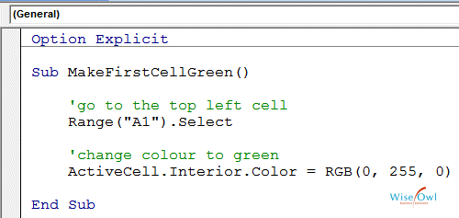
Writing Comments
When writing long blocks of code, it is always a good habit to describe the functionality of the code block
We usually begin as single quotation marks to designate a line (or block) as a comment
When a line (or block) is designated as a comment, the macro would bypass the line (or block) during execution

Slide 30
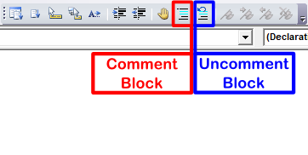
Writing Comments (cont’d.)
Besides manually adding a single quotation mark, we can highlight the specific line (or block) and click the ‘Comment Block’ button in VBE
To uncomment a line (or block), just remove the single quotation mark manually or use the ‘Uncomment Block’ button in VBE

Slide 31
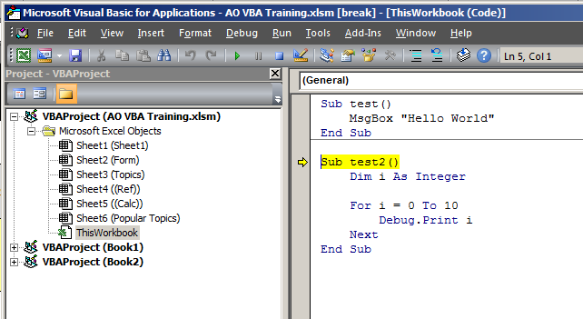
Debugging Macros
Check whether your code is working or where your code has gone wrong
To debug a macro from the first line:
Place your cursor inside the Sub or Function that you wish to debug then press F8. By default, the first line of the selected Sub or Function will be highlighted in yellow. An arrow will also be displayed on the left.

Slide 32
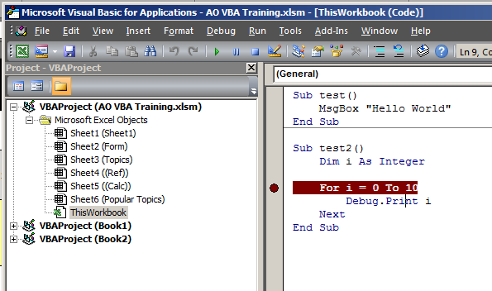
Debugging Macros (cont’d.)
To debug a macro from subsequent lines:
Create a breakpoint in the Sub or Function by clicking the side bar. A red dot will be created and the line code will be highlighted in red
Press F5. The macro will stop at the highlighted line code
Press F8 to evaluate/debug subsequent lines after breakpoint

Slide 33
Debugging Macros (cont’d.)
Other debugging tips:
Debug.Print
Immediate Window (Ctrl + G)
Comments (‘)
Add Watch under Debug in VBE

Slide 34
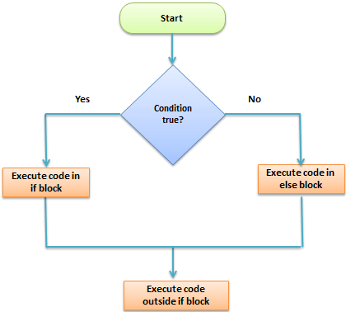
Decision Tree (If.. Else)
Used to make a decision or comparison (i.e. condition). Thereafter, select one of two paths based on the condition
Single line:
If anyDate < Now Then anyDate = Now
Multiple lines with indentation: If anyDate < Now Then anyDate = Now Msgbox (anyDate)
End If If … Then … Else

Slide 35
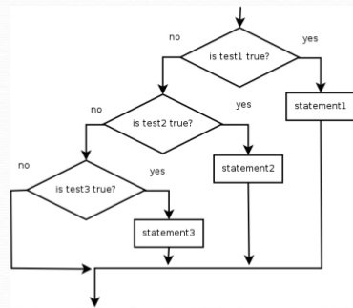
Decision Tree (Nested ifs..)
Used when testing multiple conditions and returning the relevant path/results
If Index = 0 Then ClearCells CopyCells(0)
ElseIf Index = 1 Then CopyCells(1)
ElseIf Index = 2 Then CopyCells(2) Else Msgbox(“Error”) End If

Slide 36
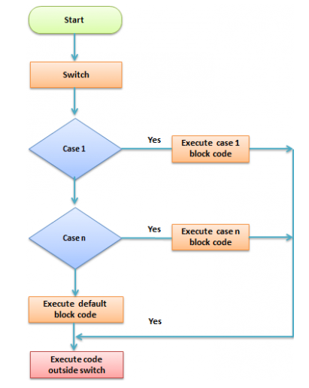
Case
When a selection structure has several paths to choose from, it is usually simpler and clearer to use the Case form instead of the Nested If form
Select Case Index Case 0 Process0 Case 1 Process1 Case 2 Process2 Case 3 Process3 Case Else Msgbox(“error”) End Select

Slide 37
Decision Tree with GoTo Statement
If x = 365 Then
GoTo FooBar1
Else
GoTo FooBar2
End If
FooBar1:
Debug.Print “Inside FooBar1”
GoTo FooEnd
FooBar2:
Debug.Print “Inside FooBar2”
FooEnd:
Debug.Print “Getting out!”
The GoTo statement simply transfers program control to a new statement. This new statement must be preceded by a label

Slide 38
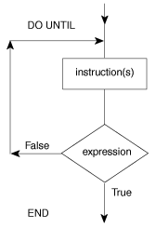
Loops/Iterations (Do Until)
Do Until means loop until true condition is obtained
Do Until condition statements Loop Do statements Loop Until condition

Slide 39
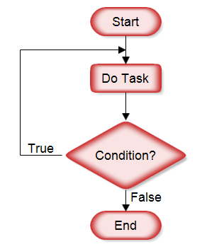
Loops/Iterations (Do While)
Do While means loop until false condition is obtained
Do While condition statements Loop Do statements Loop While condition

Slide 40
Loops/Iterations (For Loop and For Each Loop)
The For … Next statement is a repetition structure that begins with the For clause and ends with the Next clause For counter = start To end [Step increment] statements Next counter
The For Each … Next statement is another repetition structure that repeats a group of instructions for each object in a collection For Each element In group statements Next element

Slide 41
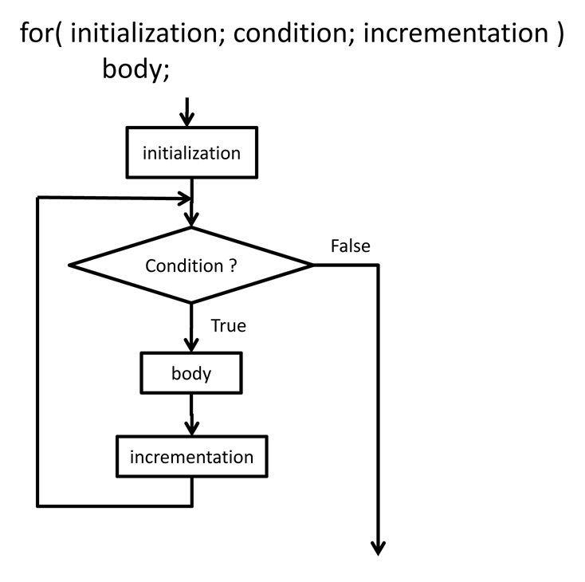
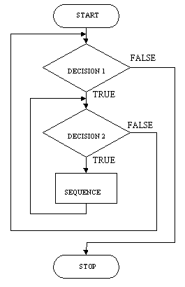
Loops/Iterations (Nested For Loop)
Similar to nested Ifs, we can also nest For loops, i.e. place one For … Next statement within another For … Next statement
For Loop | Nested For Loop

Slide 42
Exiting Control Structures
For counter = start To end [Step increment] [statement block] [Exit For] [statement block] Next [counter [, counter][, …]] Do [ {While|Until} condition]
[statement block] [Exit Do] [statement block] Loop
Can also exit from a procedure: Exit Sub
You can use the Exit For or Exit Do to exit the relevant loops prematurely.

Slide 43

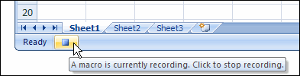
Recording Macros
Open a new blank workbook. At the bottom-left corner of the Excel workbook, click the Record Macro
Give a name to the macro
Perform the standardized actions sequentially
If you make a mistake, stop the recording (instruction in next step), close the files without saving and start the recording all over again
Once all the actions are completed sequentially, click the Stop Recording button at the bottom-left corner. Save the workbook

Slide 44
References
https://www.mrexcel.com
https://www.experts-exchange.com
https://msdn.microsoft.com
https://stackoverflow.com/
https://msdn.microsoft.com/en-us/library/cc793964.aspx
https://msdn.microsoft.com/en-us/library/gg549168.aspx
(examples of data consolidation from multiple sheets/workbooks)
http://www.homeandlearn.org/the_excel_vba_editor.html
https://www.excel-easy.com/vba.html

Slide 45
Questions?

Slide 46
Thank You
Devang Khokhani (RMD)
T: +65 6805 3961
E: devang.khokhani@mizuho-cb.com
Mishael Oblefias (MRDD)
T: +65 6805 4263
E: mishael.oblefias@mizuho-cb.com
Clement Yee (MRDD)
T: +65 6805 4243
E: clement.yee@mizuho-cb.com

